Slide 1

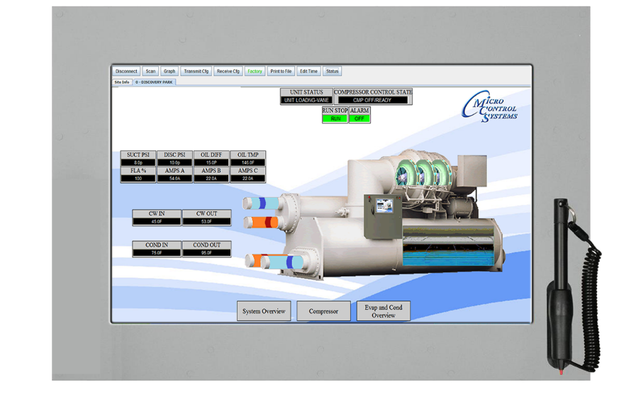
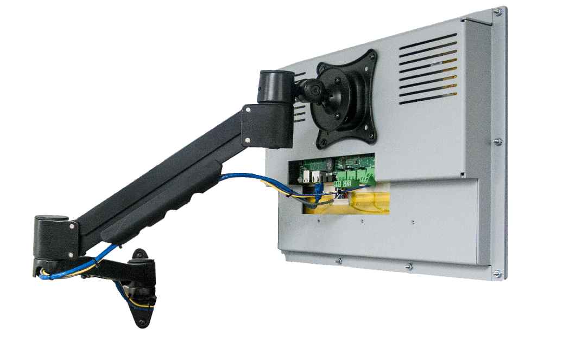
MCS-TOUCHSCREENS
Support for all Products: support@mcscontrols.com
Application Specialist: Firmware/Software: applications@mcscontrols.com
Sales for all products: sales@mcscontrols.com
General Pricing and Orders – orders@mcscontrols.com
Status-Orders and Shipping - orders@mcscontrols.com
RMA (Return Merchandise Authorization) - orders@mcscontrols.com
Revision - 4.3 5/19/2022

Slide 2
2008 - MCS Introduces 1st Touchscreens
2014 MCS Introduces next generation of High-Resolution Touchscreen 15.4”
2017 MCS Introduces High Resolution Touchscreen 10.1”
The TOUCH-10.1 and TOUCH-15.4 are touchscreen interfaces designed to simplify user access with the MCS-Magnum utilizing MCS-Connect to provide both graphics and service mode access to technicians.
Information and graphics on the TOUCH 10.1 and TOUCH 15.4 are shown on a high resolution (1280x800) LCD display with LED backlighting, which will guarantee long-life operation.
Notes:
First Touchscreens were introduced, MCS-TOUCH-PC 10.2 and MCS-TOUCH-PC15, operating system, Windows XP.
In 2014, the operating system was changed to LINUS operating system.

Slide 3

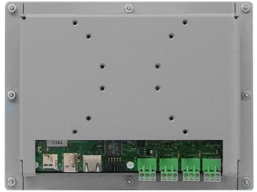
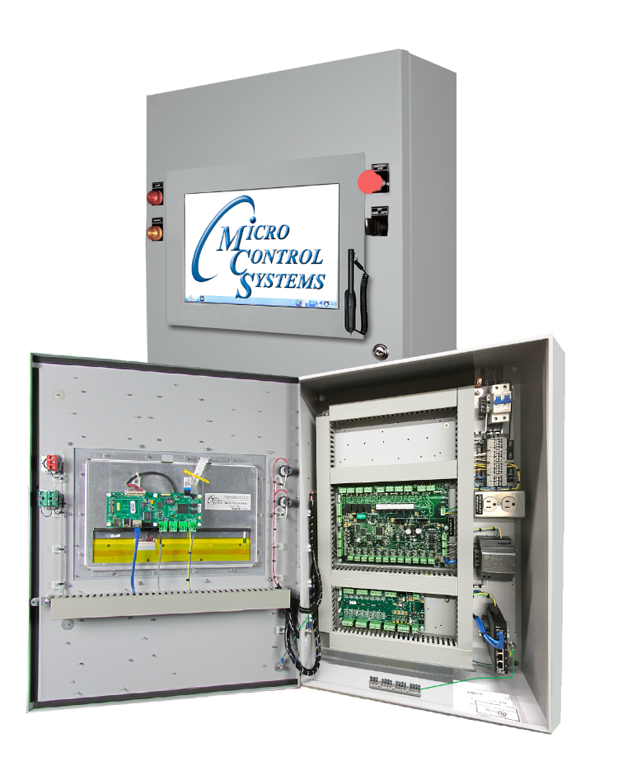
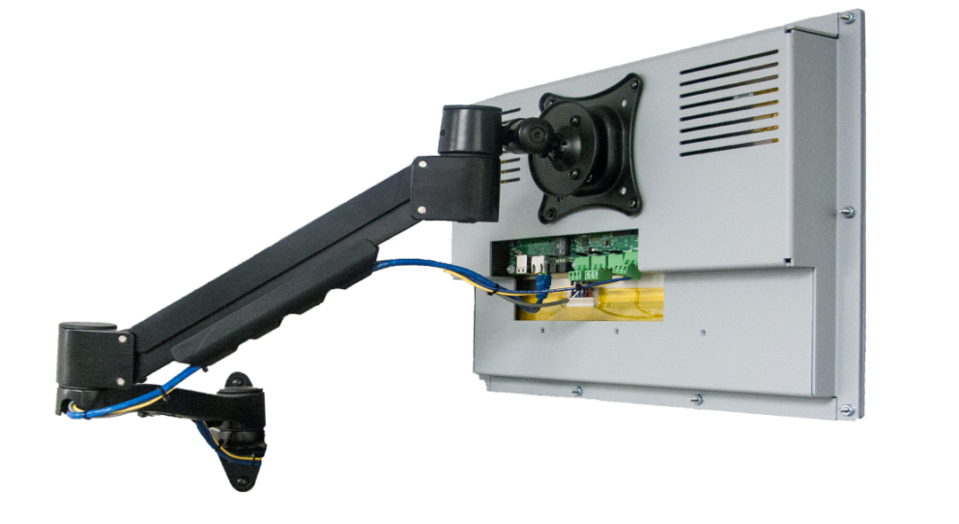
MCS-TOUCH-10.1
MCS-TOUCHSCREEN 10.1 fits Small, Medium and Large Enclosures.
Use with Vesa Mount and display in your office or mount separate from your control enclosure.
FRONT
BACK
Notes:
MCS-TOUCH-10.1 footprint helps the technician see the status and graphics better than the 7” touch. It can still be mounted in the small enclosures.

Slide 4
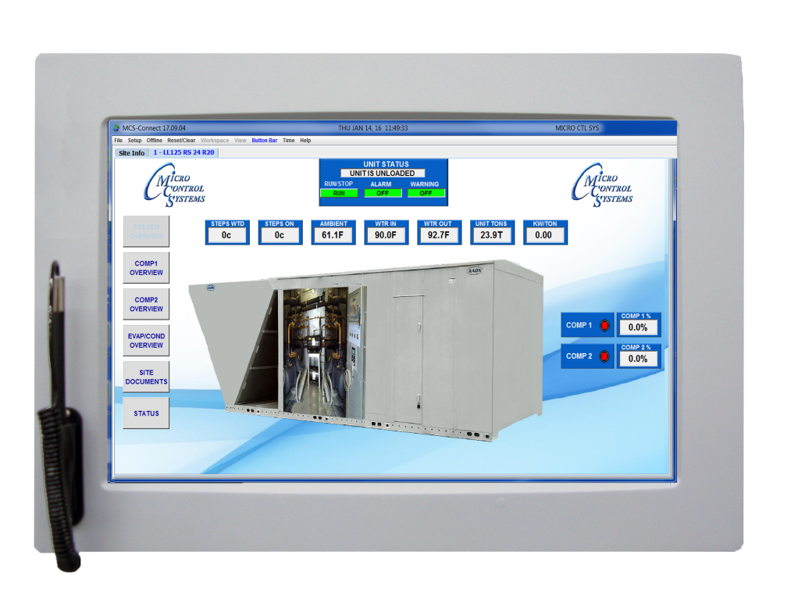
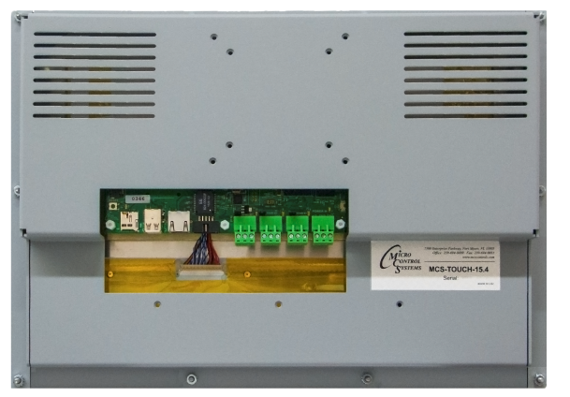
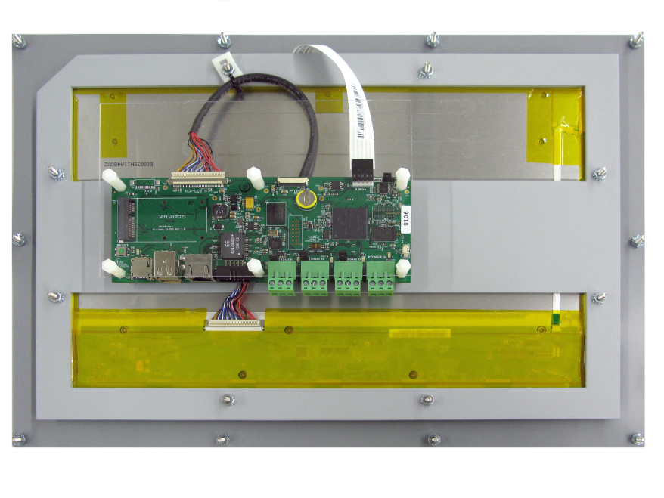


MCS-TOUCH-15.4
Larger footprint, same high-quality resolution, fits Medium and Large Enclosure
BACK
FRONT
Notes:
MCS-TOUCH 15.4 is our most popular touchscreen. Remember all touchscreens, 7”, 10.1 and 15.4 all have the same memory and resolution.
All are built using the gasket for an environment seal for a NEMA 4 rating.

Slide 5
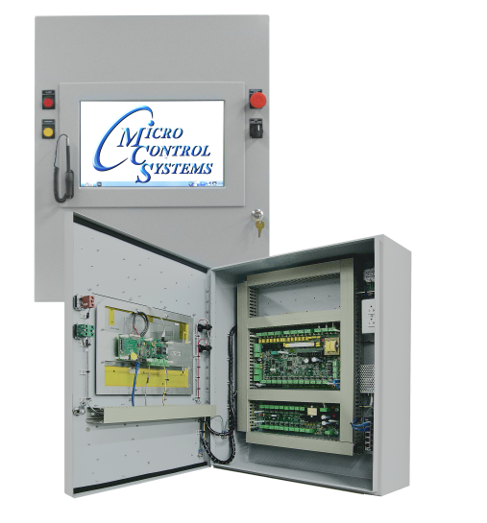
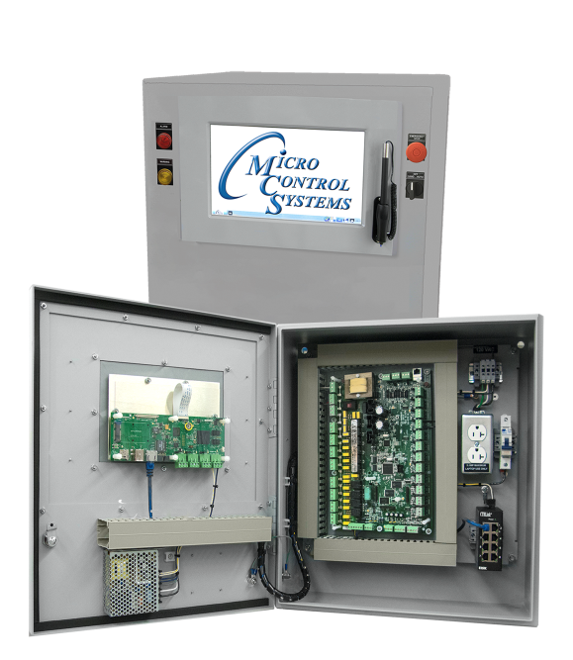
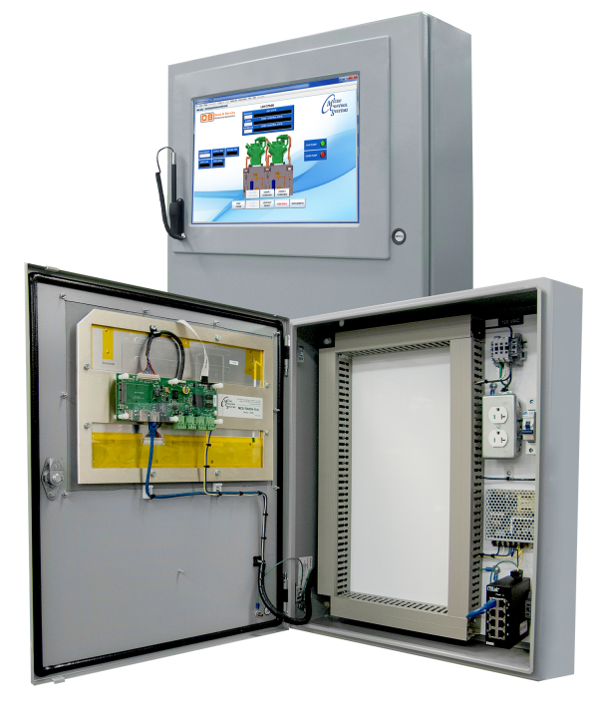
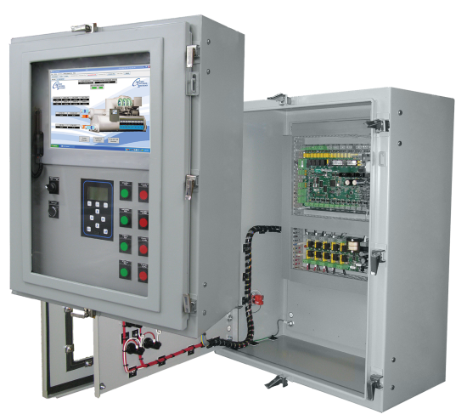
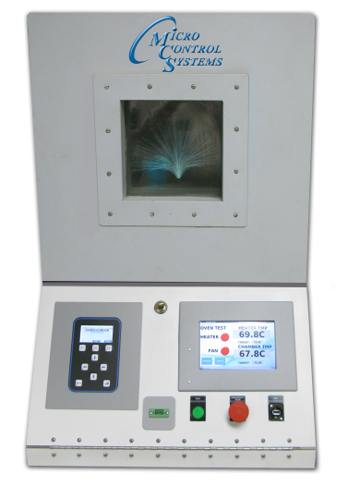
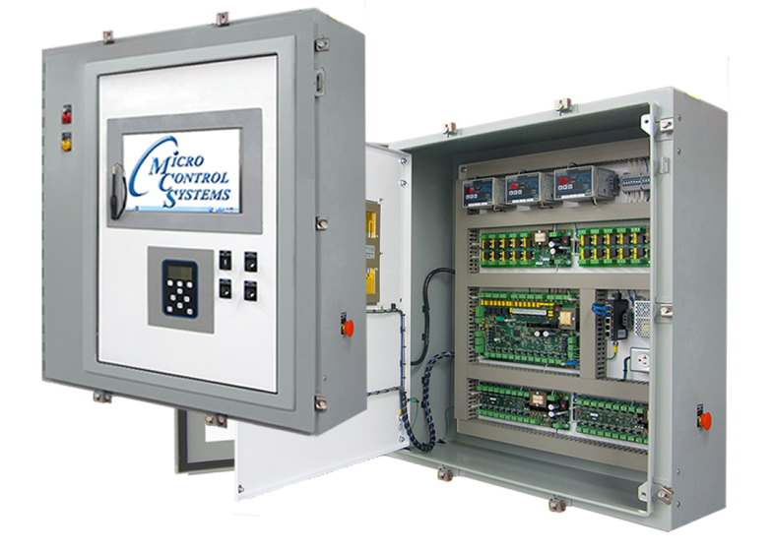
MCS-TOUCH-10.1” and 15.4”
Various Enclosurers used with touchscreens

Slide 6
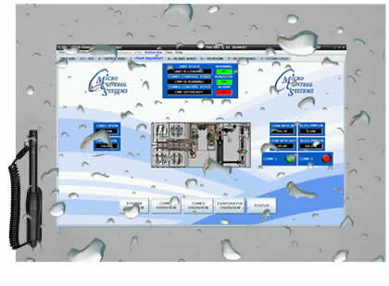

The MCS Touchscreens are suitable for installation for both indoor and outdoor applications.
Utilizing a gasket for an environment seal provides the units with a NEMA 4 rating.
Optional Cover kit available
Notes:
REMEMBER, is using in a wet environment or outdoors, the touchscreen should be installed in a NEMA4 enclosure.

Slide 7
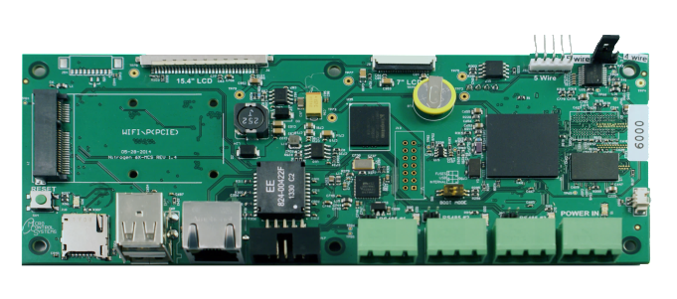
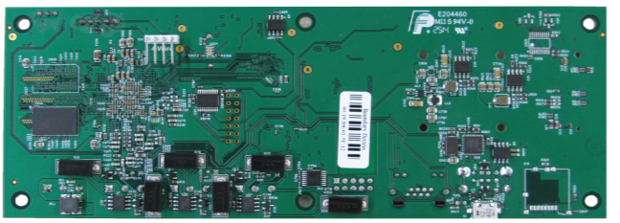
^{MCS-TOUCHSCREEN}
^{MOTHERBOARD - FRONT}
5 wire connection
15.4 Touchscreen
Freescale i.MX6
Dual Core 800mhz
15.4IN LCD Connector
16 GB EMMC
Flash Memory
^{2 GB DDR3 Memory}
Reset
Switch
MICRO
SD Slot
^{2 - USB}
^{Ports 2.0}
^{Ethernet}
^{Port}
^{3 - RS 485}
^{Communication Ports}
^{+12 V DC}
^{Power Input}
^{MCS-TOUCHSCREEN}
^{MOTHERBOARD - BACK}

Slide 8

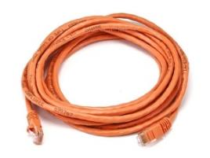
^{INCLUDED COMPONENTS}
12 VDC 90W
Single Output Power Supply for Touchscreen
Resistant to short circuiting, overloading and over voltage
Operating temperature up to 70⁰C
Ethernet Crossover Cable
7ft CAT 5e Crossover Patch Cord
Orange

Slide 9
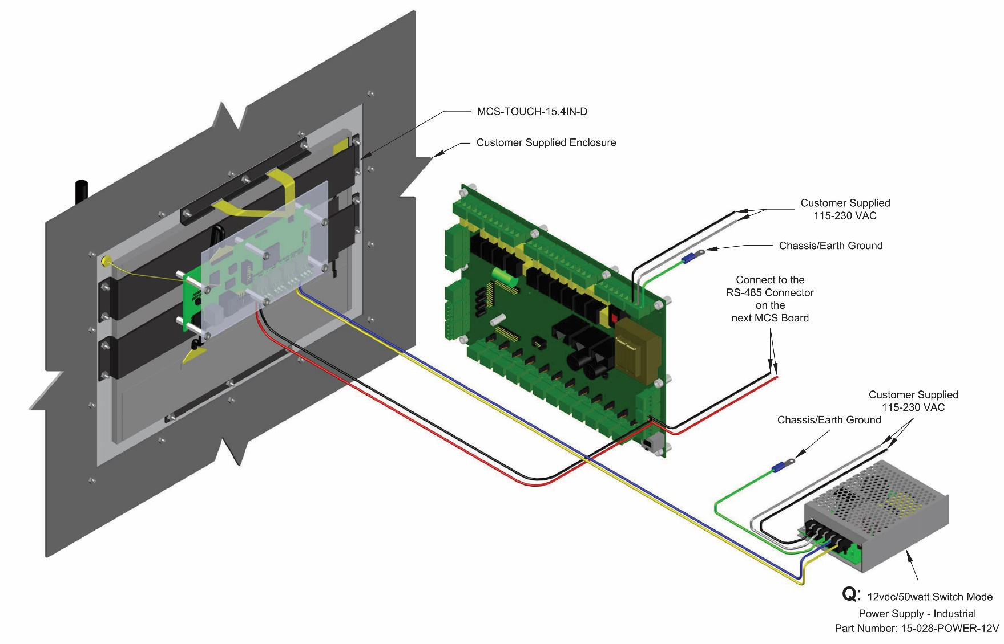
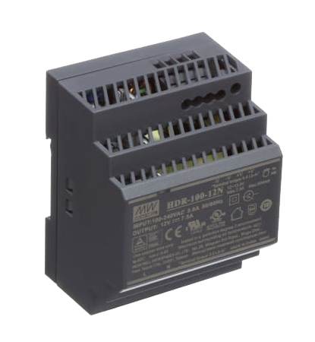
MCS-TOUCH – CONNECTION
RS-485 TO ONE MCS-MAGNUM

Slide 10
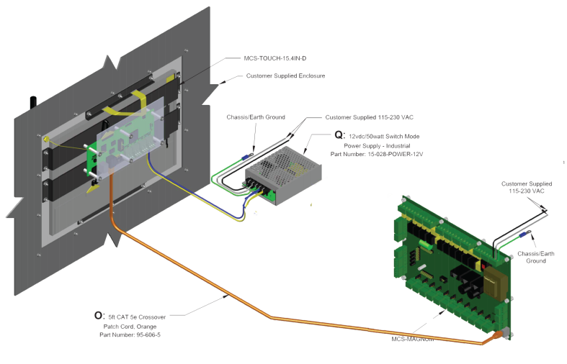
MCS-TOUCH – CONNECTION
ETHERNET TO ONE MCS-MAGNUM

Slide 11
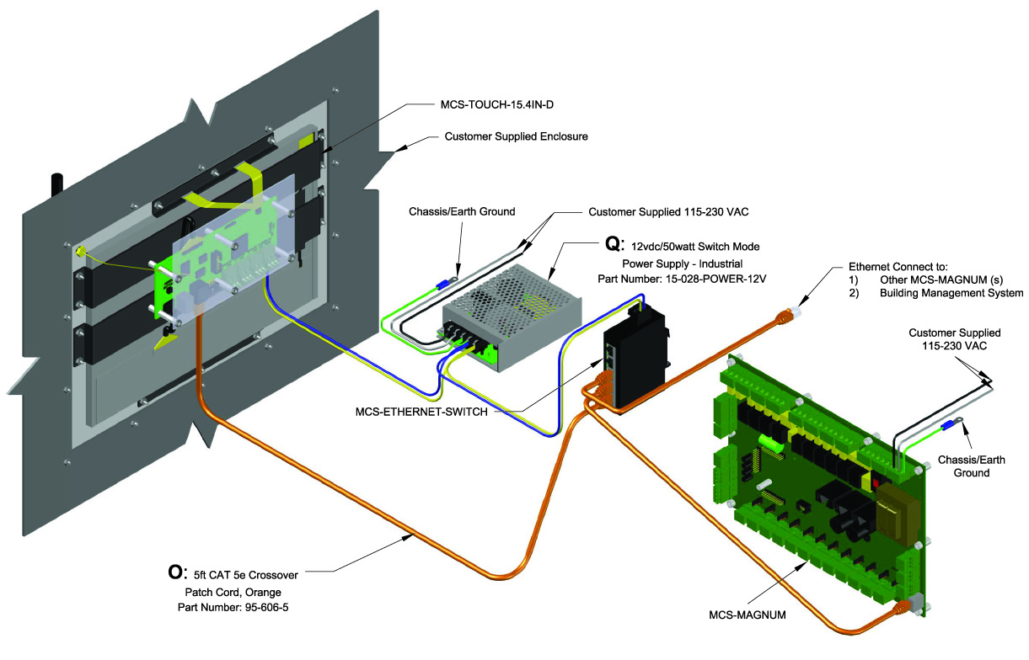
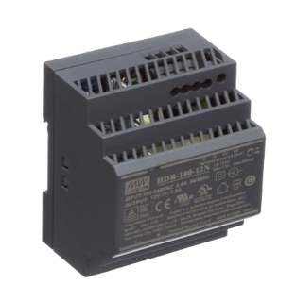
MCS-TOUCH – CONNECTION
ETHERNET TO MULTIPLE MCS-MAGNUMS

Slide 12
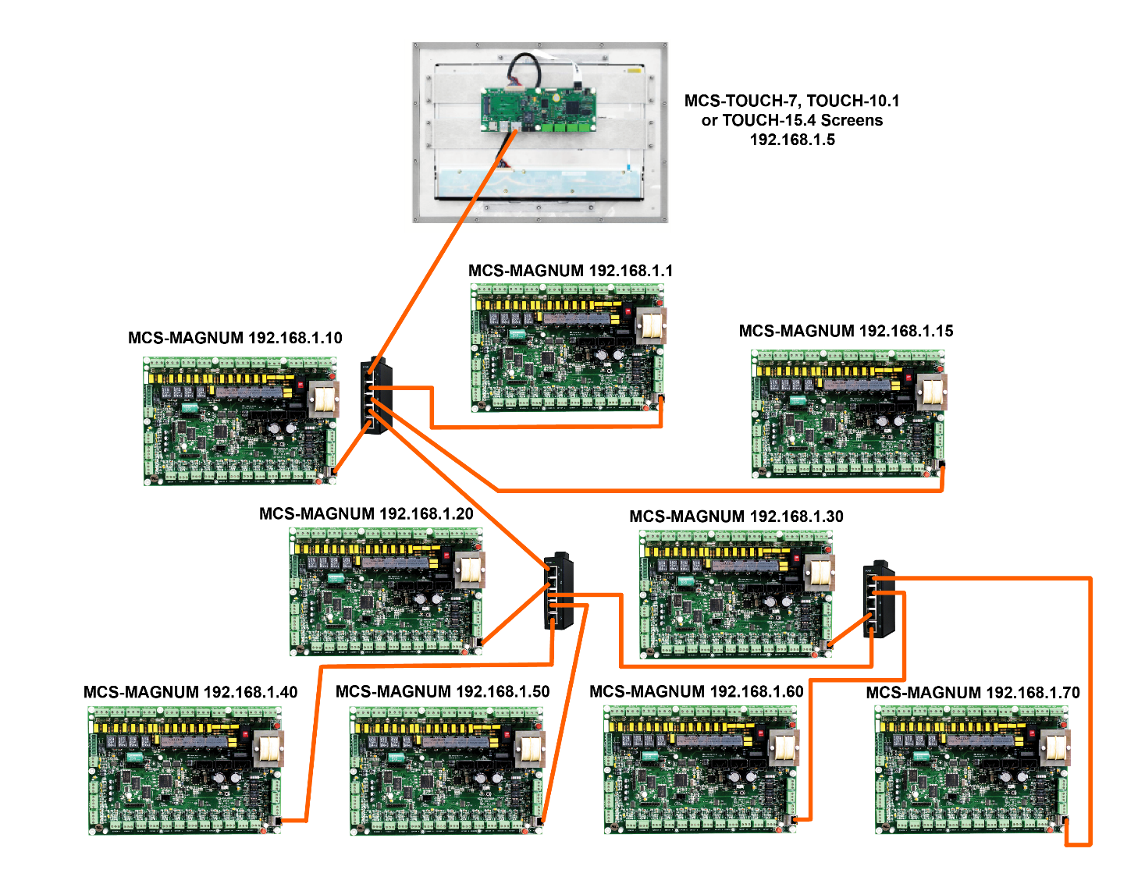
The MCS-TOUCHSCREEN can connect to up to 60 MCS Controllers at once and supports RS485 or Ethernet networking while connected to MCS-MAGNUMS.

Slide 13
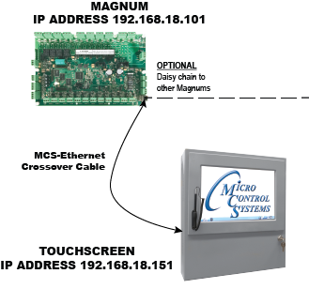
Magnum to one Touchscreen
LOCAL ETHERNET COMMUNMICATION
1

Slide 14
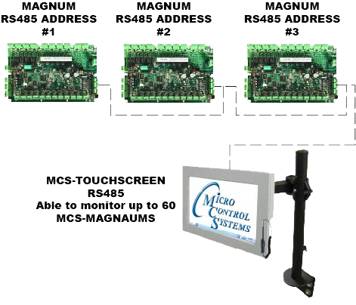
Remote Communicating
to Touchscreen
RS485 COMMUNMICATION

Slide 15
Any Questions on how to setup wiring to the Touchscreen
Ethernet? RS-485?

Slide 16
Touchscreen Exercise 1
Can a Touchscreen be mounted indoor and or outdoor?
  YES, they utilized a gasket for an environment seal which provides a NEMA4 rating. Remember, if mounting outdoors or in a wet environment, you should use a NEMA4 enclosure.
What is the Memory storage of the Touchscreens?
  16 GB EMMC Flash Memory, 2GB of DDR3 RAM Memory
How many USB PORTS are available?
  2 USB Ports, 1 Ethernet Port, 3 RS 485 ports, 1 MICRO SD Slot
Can you connect multiple MCS-MAGNUMS?
  YES, 60 MCS Controllers can be connected using RS 485 or Ethernet networking. You can switch and monitor the status of each controller connected to the network.

Slide 17
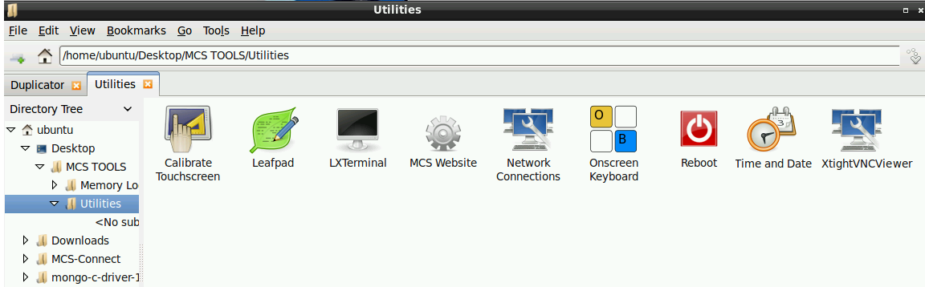
Folders in MCS Tools / Utilities
Touchscreen
Calibration
LX Terminal Terminal Emulator
Click - go to Internet to
MCS Website
Click - go to Onboard Keypad
Click - go to XtightVNCViewer
Leafpad – Text Editor
Network
Connections
Reboot
Touchscreen
Click to change date and time
Notes:
MCS Tools/ Utilities is where you can find the files to make changes to NETWORK connections, date and time, etc.

Slide 18
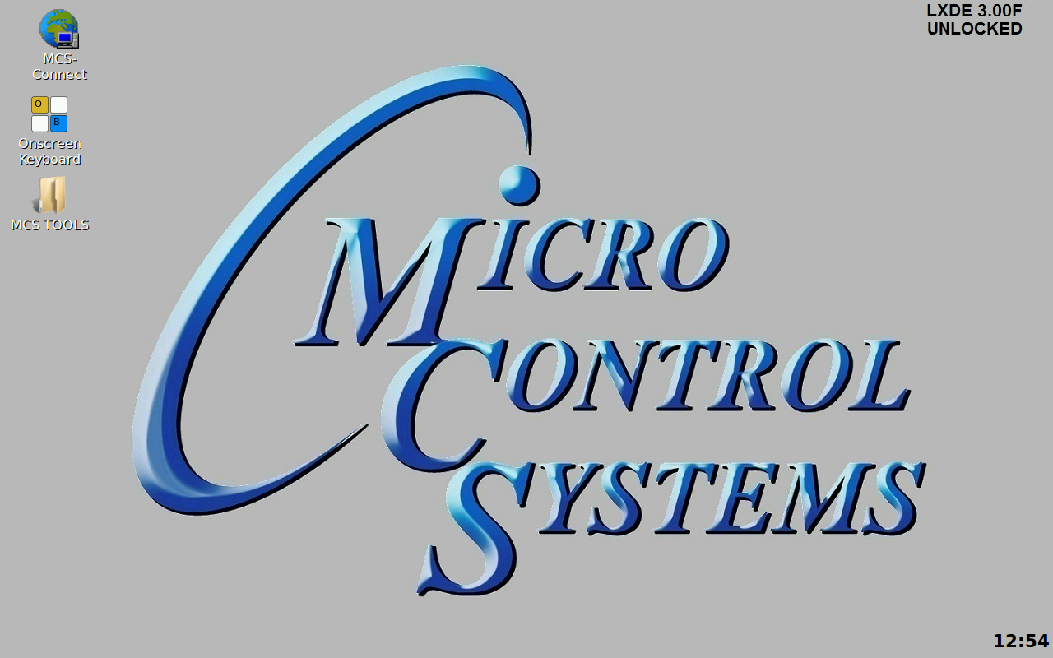
OnScreen Keyboard
Click to open onscreen keyboard at main screen
LOCKED
Click on ‘OnScreen Keyboard’
Notes:
You can get to the on screen Keyboard from the front menu screen or from the MCS-Tools / Utilities folder at the bookmark folder.

Slide 19
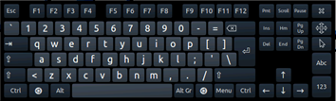
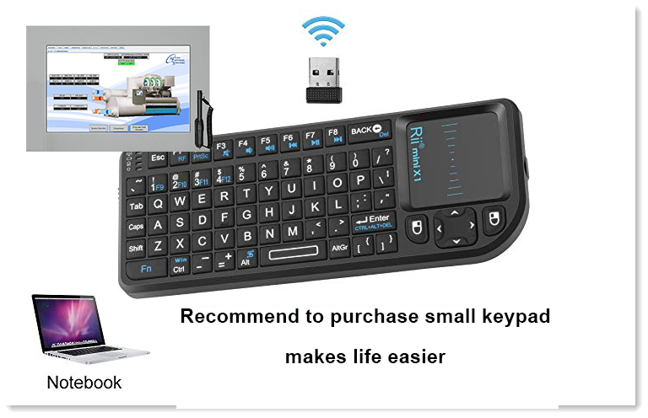
OnScreen Keyboard
LOCKED
Notes:
Talk about using on board Keypad. We recommend to purchase a mini Bluetooth Keypad which makes it much easier to get around the touchscreen.
The onboard keypad is provided in case you don’t have your own portable keypad. The onboard keypad sits in your way, on top of the screen, it makes it difficult to enter adjustments, but it’s there if you need it.

Slide 20
Locating the Files
Bookmarks, Networks
&
Graphic Files

Slide 21
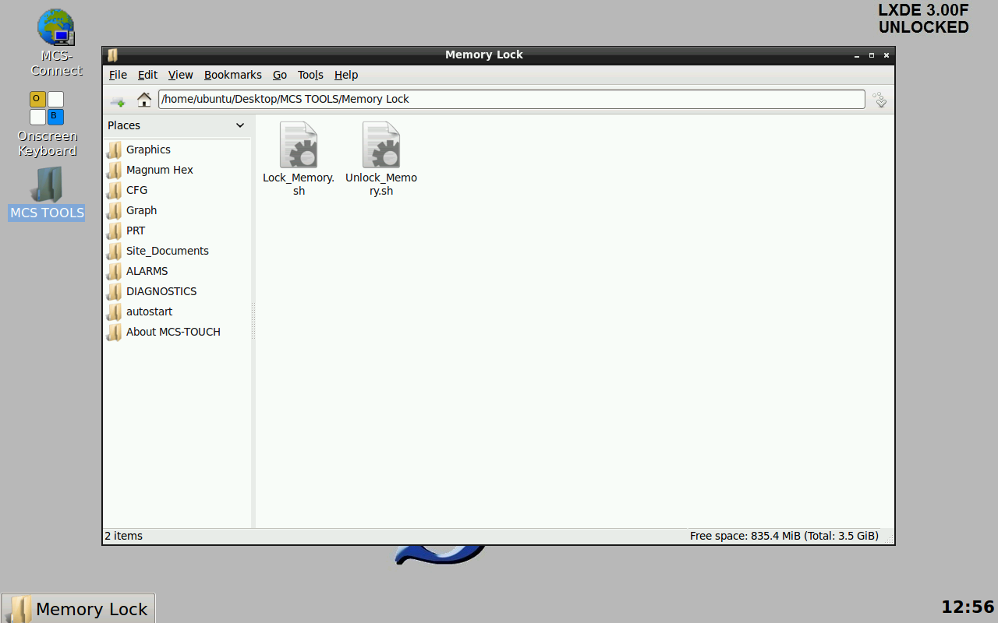
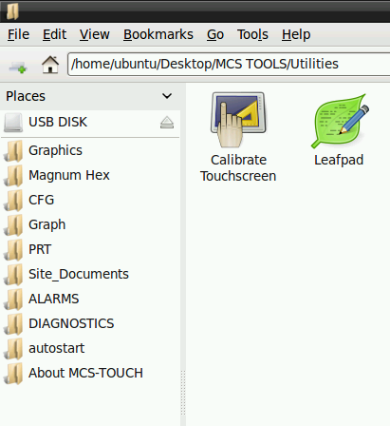
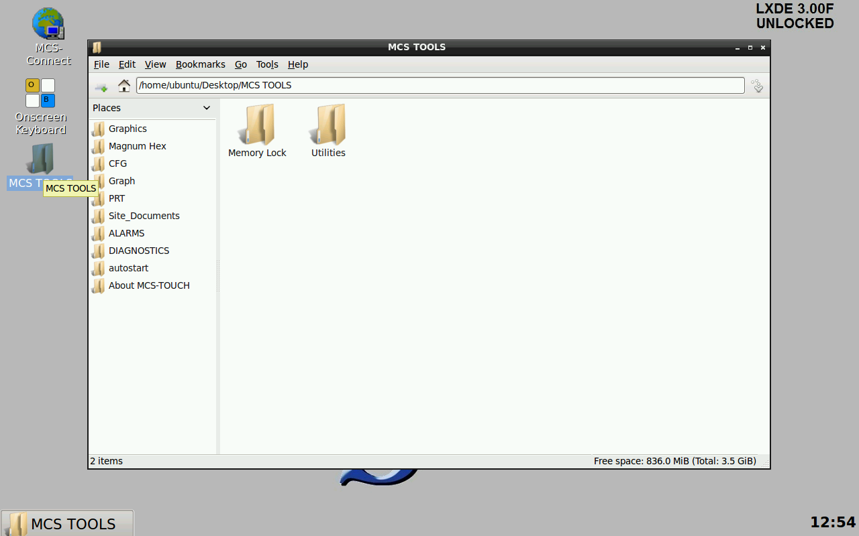
MCS Bookmarks
LOCKED
LOCKED
Click on
‘MCS TOOLS’
These are the bookmarks containing files for your touchscreen that you will need
Notes:
These are the folders and subfolders (Bookmarks) found on your touchscreen.

Slide 22
BEFORE MAKING ANY CHANGES
UNLOCK THE TOUCHSCREEN
AFTER MAKING CHANGES
RE-LOCK THE TOUCHSCREEN

Slide 23
Memory Lock
Click on Memory Lock Folder located in MCS TOOLS FOLDER
LOCKED
LOCKED
Shows status
Locked
Click on
‘MCS TOOLS’
Notes:
You will notice in the upper right corner of the touchscreen, at the main menu it will show whether the touchscreen is LOCKED or UNLOCKED.
If the touchscreen is set in full screen mode, you will need to exit to the main menu to see if it is locked or unlocked.
Also, at the main menu, you can see the current version number for the operating system. Again, if you don’t unlock the touchscreen, changes you make will not be saved.

Slide 24
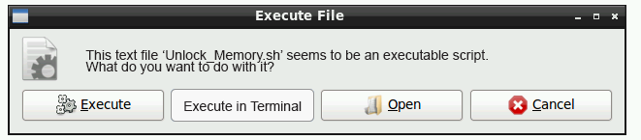
Memory Lock
Double click the Unlock_Memory.sh then press execute
LOCKED
Shows lock status
Unlocked
The touchscreen will restart and show ‘Unlocked’
Notes:
When you double click the ‘Lock Memory’ or ‘Unlock Memory, the screen will ask you to execute the script and restart the touchscreen.
Depending on how your ‘Autoexec file’ is set, you will either re-boot to the status screen or to your ‘Graphics Screen’.

Slide 25
Setting or Changing
Network Connection

Slide 26
Setting Network Connections
At main screen click on MCS TOOLS
Click on
‘MCS TOOLS’
Notes:
Click on the MCS-TOOLS to find the ‘UTILITIES’ where the NETWORK CONNECTIONS sub folder is located.

Slide 27
Setting up Network
Click on Utilities Folder

Slide 28
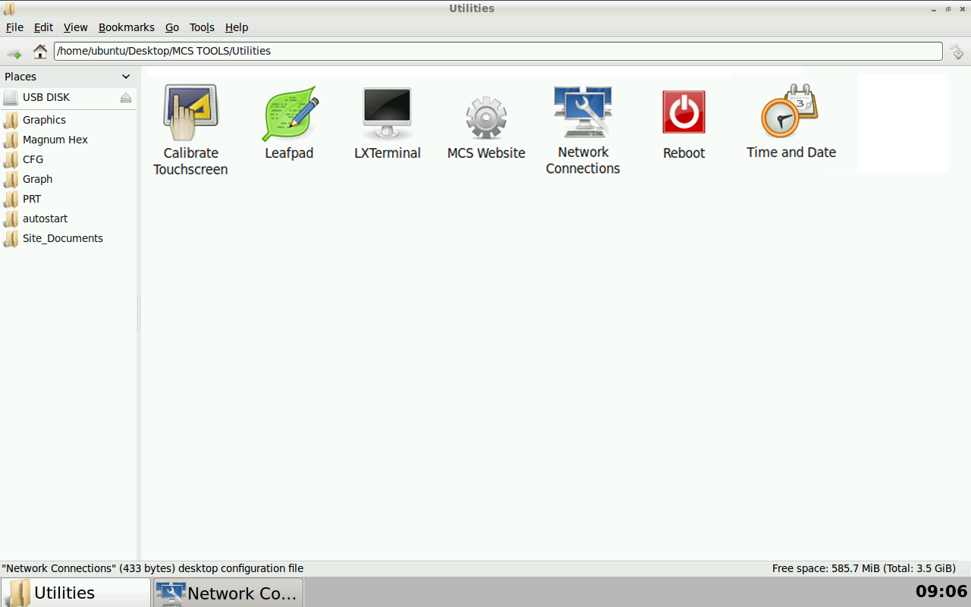
Setting up Network
Click on Network Connections

Slide 29
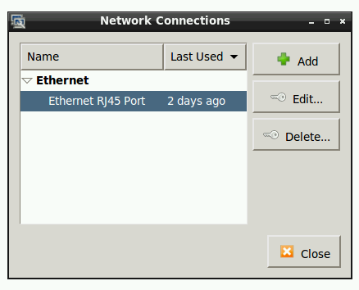
Setting up Network
Click to edit this connection

Slide 30
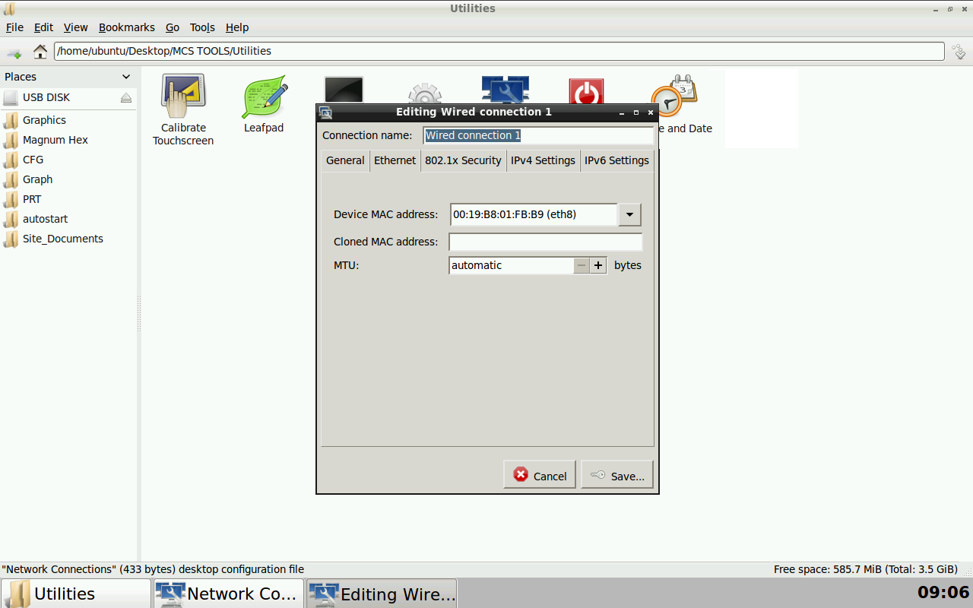
Static IP, Netmask & Gateway Address
You can change the name of connection to help identify the touchscreen.
Click the dropdown and find the correct network device (eth*)

Slide 31
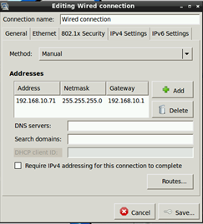
Static IP, Netmask & Gateway Address
Click on IPV4 settings - enter IP Address, Netmask and gateway addresses.
Set to Manual for Static IP, or Automatic for Dynamic IP
Enter Static IP, Netmask & Gateway Address
Click to save
Notes:
Make sure after making changes, you save the changes. If your finished making changes, LOCK THE TOUCHSCREEN to ensure changes are saved to memory.

Slide 32
Changing Time / Date
Training class to Change date

Slide 33
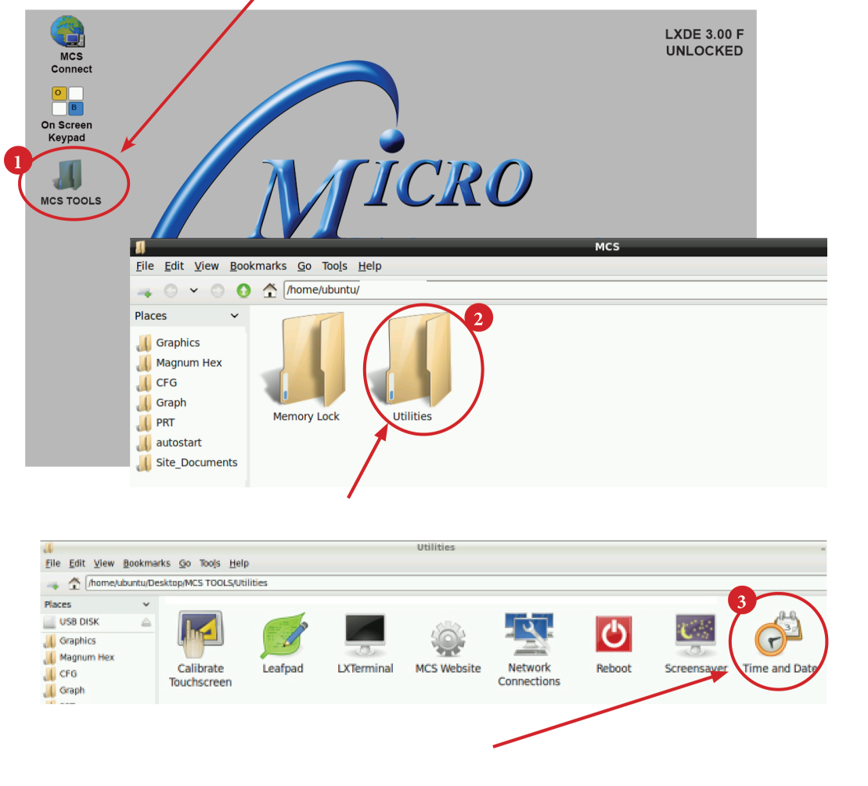
Setting Time and Date –
Navigate to the MCS TOOLS folder on your desktop.
Double click to open.
Double click on the UTILITIES sub folder to view contents.
Double click TIME AND DATE to make changes.

Slide 34
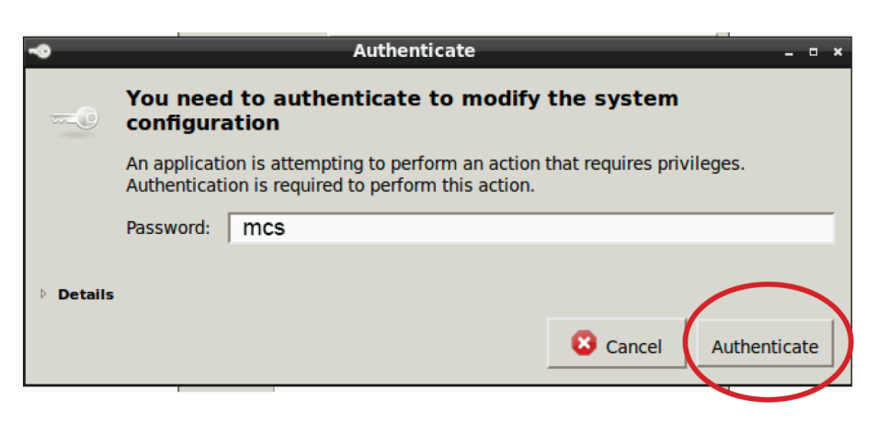
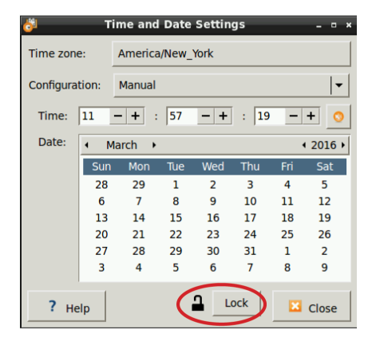

Screen opens- click on UNLOCK
YOU MUST BE AUTHORIZED TO MAKE THESE CHANGES.
Enter password ‘mcs’ (lower case) for password
Click AUTHENTICATE to unlock
Make changes to
date or time and click LOCK to relock.
TOUCHSCREEN MUST BE RELOCKED IF YOU ARE FINISHED MAKING CHANGES
Notes:
Again, Touchscreen must be ‘UNLOCKED’ and than ‘RELOCKED’ to save the changes.

Slide 35
Working with the AutoStart File
Open MCS-CONNECT
from Main MENU
Training class start MCS-CONNECT
And work with Autostart

Slide 36
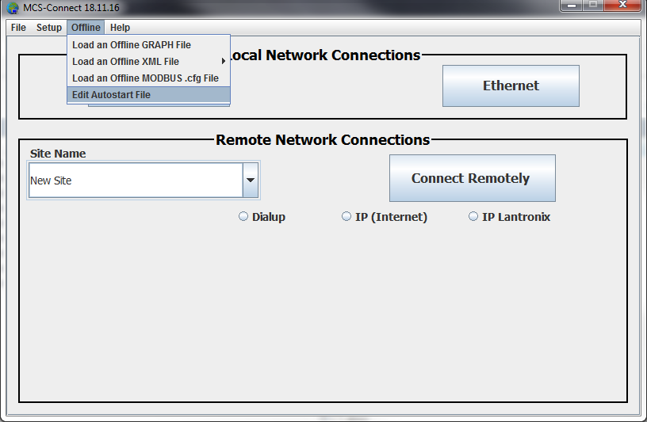
MCS-CONNECT AUTOSTART for the Touchscreen
Click on the Edit Autostart File at the MCS-CONNECT start screen
This is the autostart file that runs a set of arguments to automatically connect to your Magnum.
Notes:
Autostart boot config file runs in background to start MCS-CONNECT

Slide 37
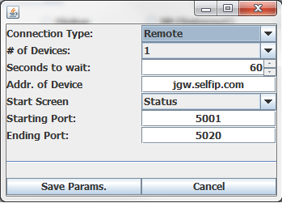
Autostart Boot Config File
Autostart boot config file runs in background to start MCS-CONNECT
SERIAL (LOCAL) – RS485 CONNECTION
  If needed you can edit:
  Connection type
  # of Devices
  Seconds to Wait:
1
Addr. of Controller
Start Screen
Starting Port:
Ending Port:
SAVE THE PARAMS. WHEN FINISHED
Notes:
Make sure that if you need to change something in the Autostart file that you make a backup of MCS-CONNECT in case your changes are not made correctly.

Slide 38
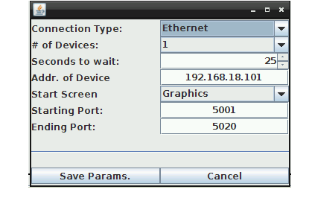
Autostart Boot Config File
Autostart boot config file runs in background to start MCS-CONNECT
ETHERNET CONNECTION
  If needed you can edit:
  Connection type
  # of Devices
  Seconds to Wait:
Addr. of Controller
Start Screen
Starting Port:
Ending Port:
SAVE THE PARAMS. WHEN FINISHED
Notes:
Make sure that if you need to change something in the Autostart file that you make a backup of MCS-CONNECT in case your changes are not made correctly.

Slide 39

TOUCH SCREEN
CALIBRATION
TOUCHSCREEN MUST BE
UNLOCKED TO CALIBRATE

Slide 40
Calibrating MCS-TOUCHSCREENS
Click on MCS TOOLS on the desktop
Click on ‘UTILITIES’
Double Click ‘Calibrate Touchscreen’

Slide 41
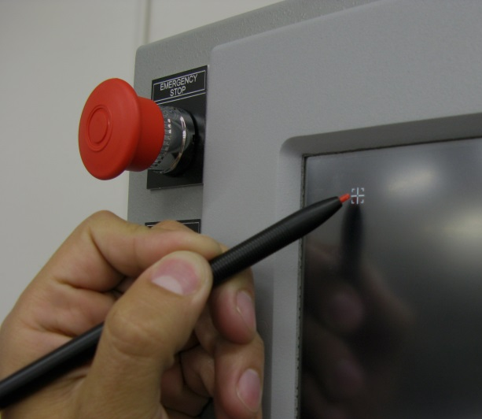
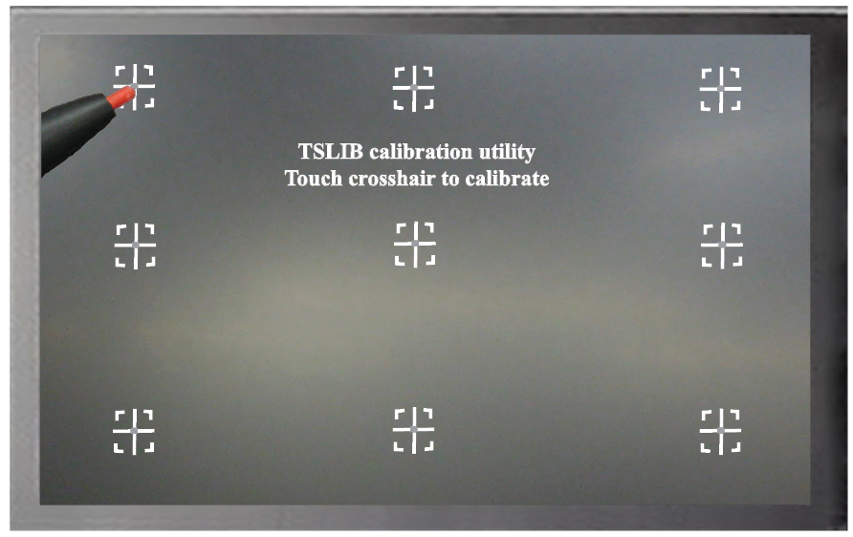
Calibrating MCS-TOUCHSCREEN (cont)
Calibration screen will open with “top left target’ showing as screen below
Hold ‘Stylus Pen, and position point to the center of the target
DO NOT TOUCH ANY OTHER PORTION OF THE SCREEN
After touching center of first target, next target will appear in the center of the screen, point to each target until all nine targets have appeared on the screen
Notes:
Very, very important, when calibrating your touchscreen, make sure you do not touch any other part of the screen as you touch one of the nine points.

Slide 42
Calibrating MCS-TOUCHSCREEN (cont.)
If satisfied with the calibration, go to the next step. If needed, rerun the calibration tool.
After you calibrated all 9 points on the screen you will be returned to the desktop.
LOCKING THE TOUCHSCREEN AFTER CALIBRATION
1. Click on ‘MCS TOOLS FOLDER’ to open
2. Click on ‘MEMORY LOCK’, CLICK ON ‘LOCK MEMORY’, click on ‘EXECUTE’
When the Lock Memory file is pressed it does an
automatic reboot and autostarts MCS-Connect
Notes:
Again, the touchscreen must be unlocked prion to calibrating the touchscreen and than relocked to save the changes made.

Slide 43
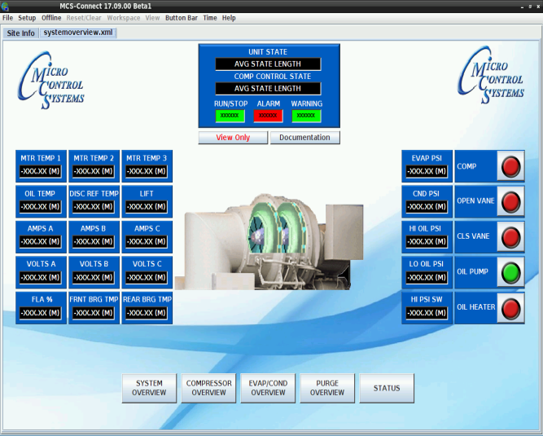
MCS-TOUCHSCREENS GRAPHICS
Replacing Graphics
Tools Needed:
1 USB stick- format new – used for copying old graphic files for backup.
1 USB stick- format new – used to copy new graphic files from your computer.

Slide 44
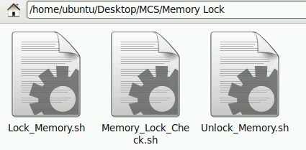
Unlock Touchscreen
Linux Software - Start by Unlocking the Touchscreen
  Click on the MCS TOOLS folder on the desktop.
  Memory Lock sub folder will appear when the file is opened.
  Double click on the Memory Lock folder
  Double click on the Unlock Memory icon
  Next screen, click on Execute
  Touchscreen will perform a restart

Slide 45
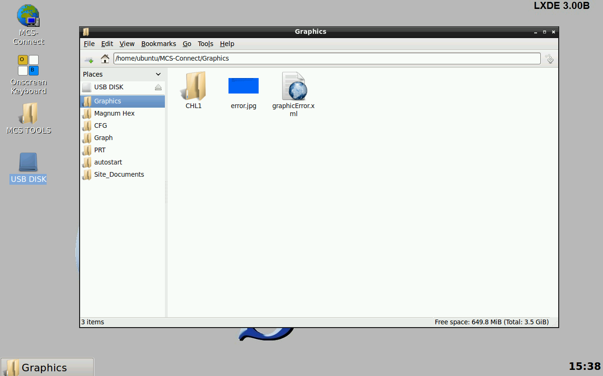
Locate Graphic Files
  Installed on the Touchscreen Flash memory located in the Graphic subfolder.
1. Navigate to the ‘Desktop’ on your touchscreen.
2. Click on ‘MCS TOOLS’ to view the tools folder and sub folders.
    a. Bookmarks will appear on the left of your screen.
    b. Click on the ‘GRAPHICS’ folder.
    c. Locate your Graphics folder (this example shows ‘CHL1’ which contains the files needed for the graphics on your touchscreen,
      (Your file will have a different name (Trane, Carrier, etc.)

Slide 46
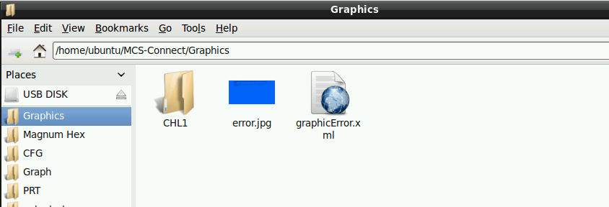


MCS-CONNECT GRAPHIC FILES
Click on the Graphics bookmark, ‘chl1’ graphic folder appears, graphics files are stored in this example main folder (CHL1).
    If you are updating or changing your Touchscreen Graphics –
    Copy this entire folder and make a BACKUP OF THIS FILE to a USB DISK.

Slide 47

Replacing Graphic Files
Step 1 – Download the emailed file from OEM or MCS to your computer desktop.
Step 2 – Click on file to unzip (DO NOT COPY UNZIPPED FILE).
Step 3 – Click on subfolder which contains your graphic file.
Step 4 – Copy this folder, ‘CHL1’, new graphic file to a formatted USB Stick.
Step 5 – Plug the USB Stick with the new graphics file into the back of the touchscreen.

Slide 48

Replacing Graphic File (continued)
Step 6 – On Touchscreen, double click on the USB DISK to open
Step 7 – Click on the new graphic file ‘cutaway’ and click on copy under edit.
Step 8 – On bookmarks, click on graphics, double click on ‘CHL1’ folder and click on paste under edit. Your new graphics will be located in the subfolder in ‘CHL1 graphics folder’.
CHL1

Slide 49

Touchscreen Exercise 2
IMPORTANT THINGS TO REMEMBER
WHEN CHANGING GRAPHIC FILE
BACKUP OLD GRAPHIC FILE BEFORE REPLACING.
UNZIP NEW FILE FROM OEM OR MCS TO YOUR COMPUTER DESKTOP AND COPY ONLY THE FILE NEEDED TO A USB STICK.
COPY AND PASTE NEW GRAPHIC FILE TO THE SUBFOLDER WHERE YOU DELETED THE OLD FILE.
MCS-CONNECT POINTS TO THE GRAPHIC FILE AS SHOWN IN THE SERVICE WINDOW OF MCS-CONNECT.

Slide 50
Touchscreen Exercise 3
What’s the most important thing to do before making any changes to your Touchscreens?
  UNLOCK THE TOUCHSCREEN. No changes can be made unless the touchscreen Is unlocked.
How do you make changes to your Network Connection?
  First, click on MCS TOOLS on front screen, Open Utilities folder, Click on Network Connections, Click the Edit tool under Network Connections
Can anyone change the time or date on a touchscreen?
  NO, you must be authorized in the system to make these changes, remember the touchscreen must be unlocked first.
How many points are involved in calibrating the Touchscreen?
  NINE TOUCH POINTS, remember not to touch any other part of the touchscreen when calibrating these points AND REMEMBER TO LOCK THE TOUCHSCREEN WHEN FINISHED.

Slide 51
For additional information please visit our website www.mcscontrols.com
Or call MCS at 239-694-0089
Support for all Products: support@mcscontrols.com
Application Specialist: Firmware/Software: applications@mcscontrols.com
Sales for all products: sales@mcscontrols.com
General Pricing and Orders – orders@mcscontrols.com
Status-Orders and Shipping - orders@mcscontrols.com
RMA (Return Merchandise Authorization):orders@mcscontrols.com

