Slide 1

WHO IS MCS
HOW OUR PRODUCTS ARE USED
WHAT IS THE BENEFIT OF INSTALLING MCS CONTROLS
REV. 2.1 - June 9, 2022
Notes:
Start Presentation with this screen remaining until class is settled.
Techs working in the field are witness to how easy it is to understand our products and their reliability, therefore they become salespeople for us.

Slide 2

What we do
Design & Manufacture Microprocessor HVAC/R controls
Product manufactured for OEM and Contractors
Over 70K controllers shipped worldwide
USA Distributor of Hanbell Screw Compressors
Notes:
Talk about What we do.
How we are setup in manufacturing.
Who we manufacture controls for and how they are sold throughout the world.
Move on to talking about the relationship with Hanbell, where they are manufactured and how we are the North American Distributor.
Go over Customer Location, Customer Types, emphasis Nuclear and the testing necessary for our controls to be used in these power plants.
Talk about the HVAC groups we support including EMCOR, etc.

Slide 3
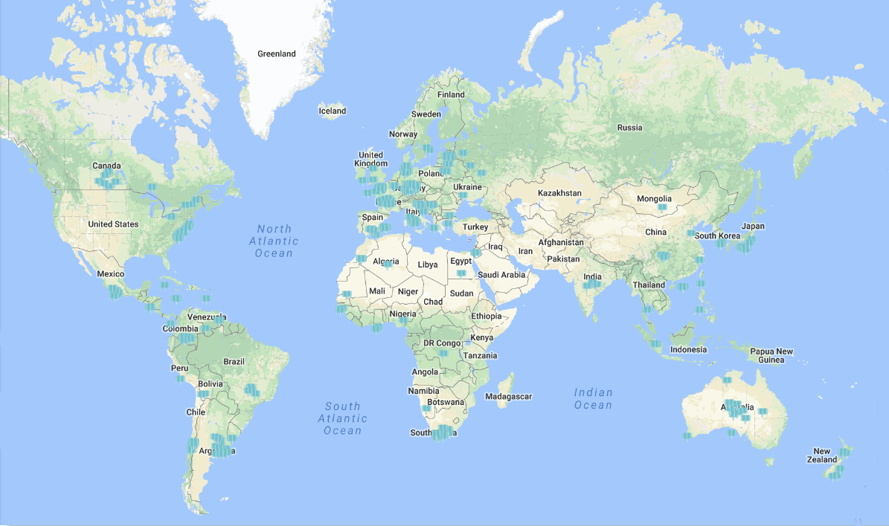
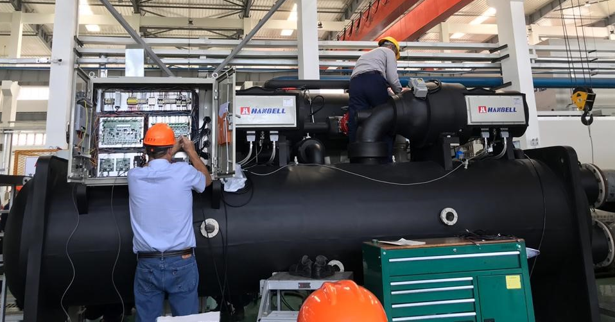
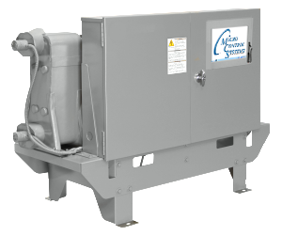
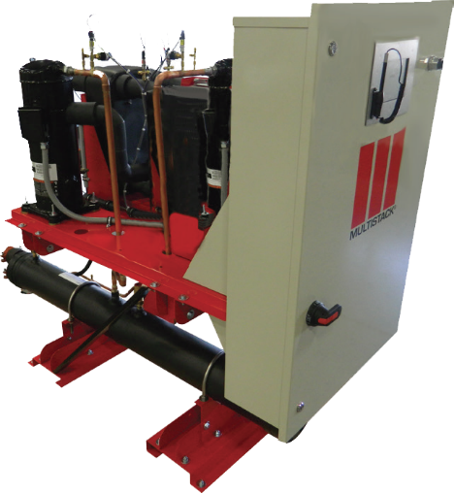
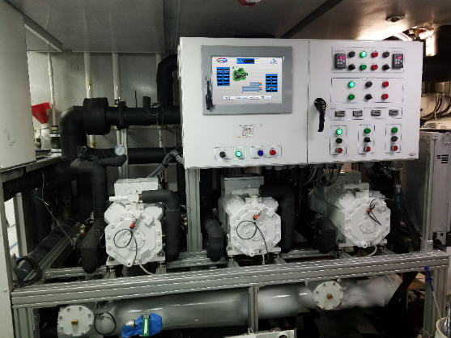
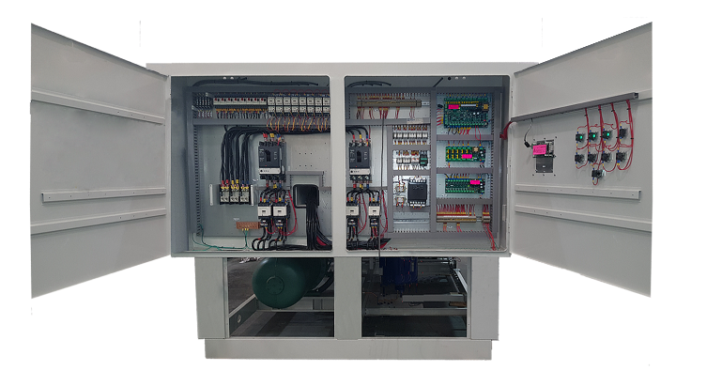
OEM Customer -
around the world
using MCS Controllers and Products
MCS controls on new Napps Chiller, USA
MCS controls on new chiller running Hanbell RTM compressors
MCS controls on new Multistack Chiller, USA
MCS controls on new Zamil Chiller, Saudi Arabia
MCS controls on Cuge Marine installation
Notes:
Our controls and products are used through out the world and are running on many new chillers.
First photo, Brian setting up controls on new Chiller in Malaysia
Next photo, shows our controls being used in the Marine industry on large yachts crossing the seas
Photos showing controls on OEM chillers in US and overseas.

Slide 4

















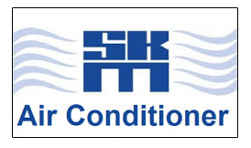



Examples of International ORIGINAL EQUIPMENT MANUFACTURERS installing MCS PRODUCTS

Slide 5
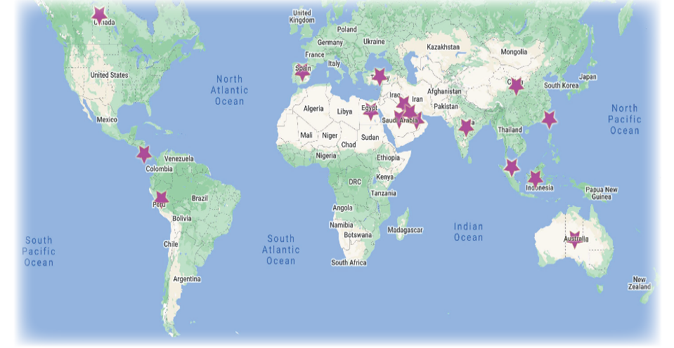
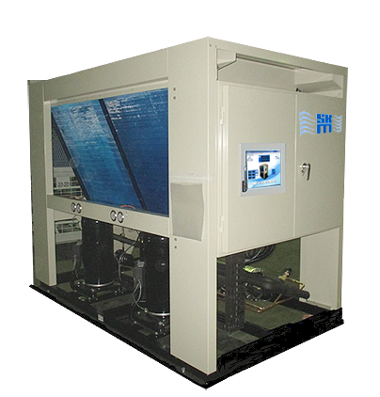
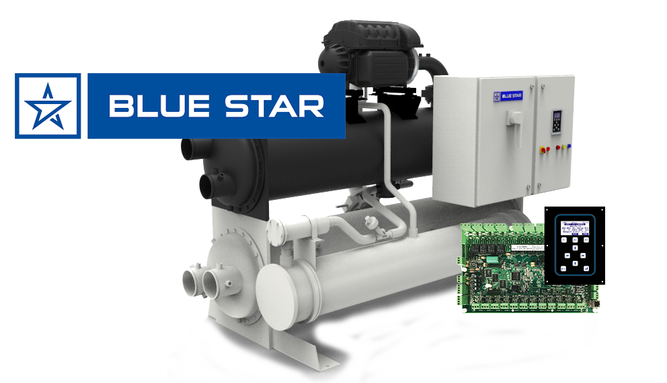
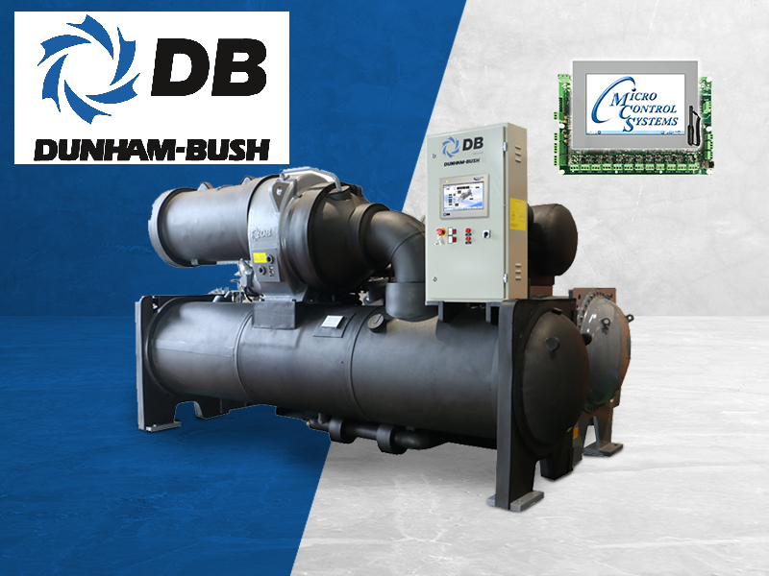

Malaysia
INDIA
UAE
Saudi Arabia
Examples of some International Equipment Manufacturers installing MCS products in their units

Slide 6
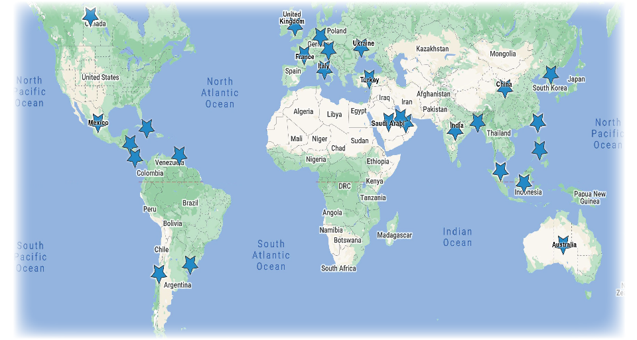

Map shows International Contractors
who install MCS Products around the world

Slide 7
Examples of UNITED STATES ORIGINAL EQUIPMENT MANUFACTURERS INSTALLING MCS PRODUCTS

Slide 8
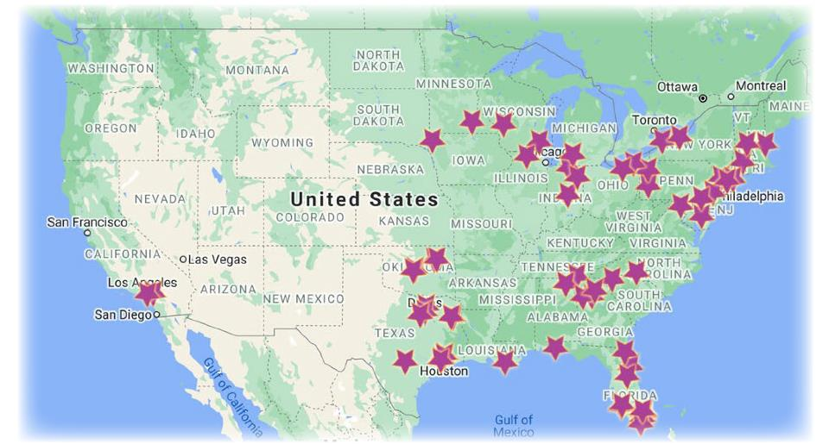


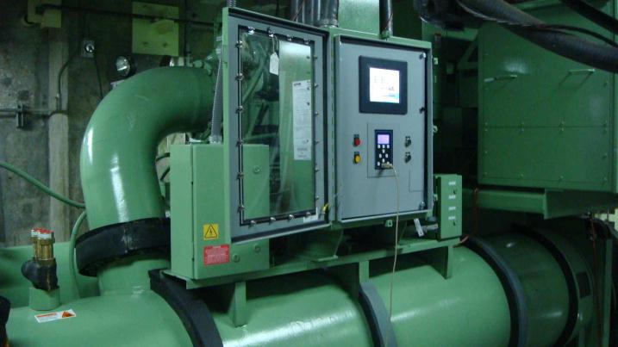


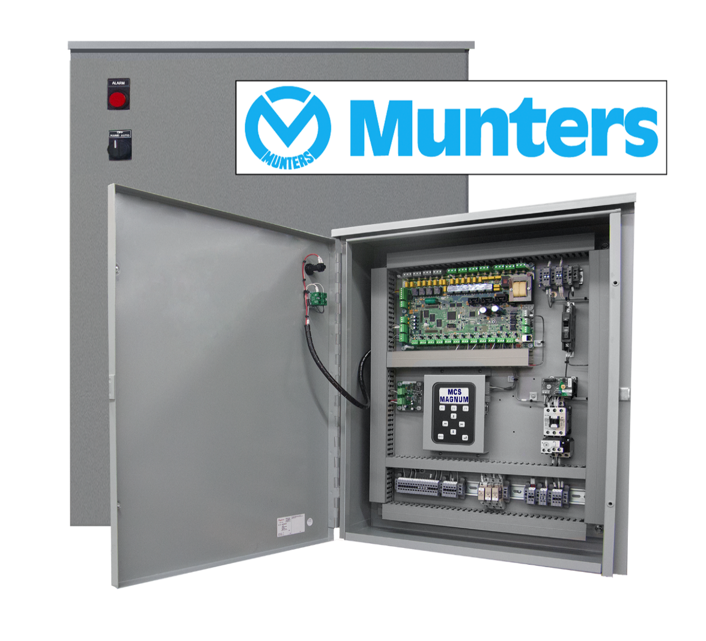

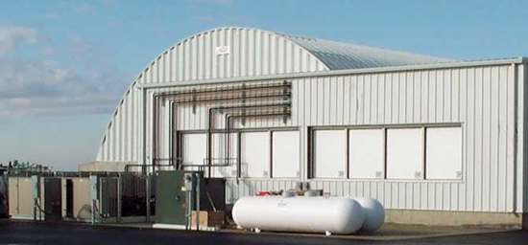

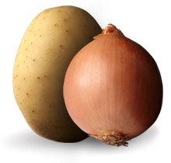
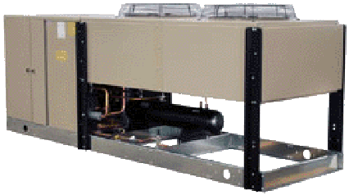
Examples of some Equipment Manufacturers in US installing MCS products in their units

Slide 9
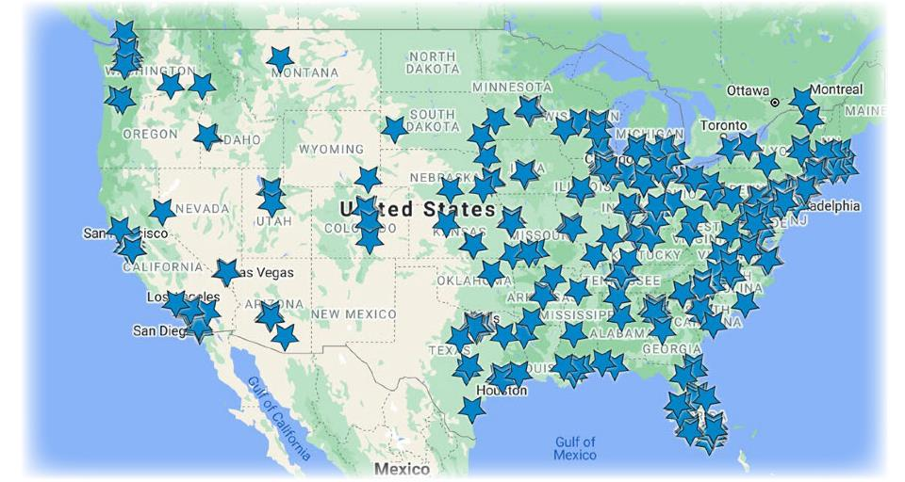
Contractors across the United States
who install MCS products

Slide 10


OEM Customer - SpaceX
United States
Supplying HVAC controls and products to SpaceX
Notes:
MCS has worked with suppling controls for the space programs over the years. Controls have been used in vehicles used for moving the spaceships in position prior to launch.
We are in the process of upgrading chillers for SpaceX.

Slide 11



Contractors Upgrades
/ New Installs
*Seismic Tested, Software Validated and EMC/EMI Tested for control of Safety Chillers
Put decades of experience to work on your HVAC/R equipment with MCS Controllers
Notes:
Working with our partner in Nuclear, upgrades are being installed on some of their older chillers.

Slide 12
MCS Philosophy
  High Efficiency Control Systems
  Is a “Non-Proprietary Controller”
  Never “Obsolete & Abandoned”
  New products are backward compatible
  Components are UL Recognized
Notes:
Important points to make about MCS.
Go over the point of quality control on manufacturing of our control products.
Go over the ‘Non-Proprietary Controller’ and how this is beneficial in the field where there might be different chillers. Our controls can monitor up to 60 different controllers running on different chillers.
Go over how our products are backward compatible, importance when upgrading.
Talk about how critical components are UL recognized.
We are now building 12volt systems and are working with UL to have our enclosures UL recognized.

Slide 13
When to use MCS
Three opportunities:
  Machine is down & time is critical
  Current control is obsolete / upgrade
  Re-engineer / Reallocation of equipment
Notes:
Talk about opportunities for upgrading to MCS controls.
Emphasize quick shipment on controls and compressors, Controls can ship in 5-7 days, faster if necessary.
We prebuild controls for inventory and custom prior to shipping.
Compressors are stored and can be changed here at our plant for special applications.

Slide 14
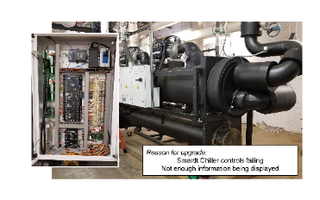

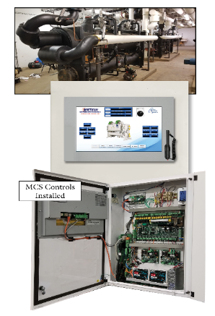
Upgrades
For Contractors on older chillers
BEFORE
Concerns:
            Old controls failed on Smardt Chiller
            Wanted controls that were easier to understand and more reliable, plus displayed more information
AFTER
Steps Taken:
Remove existing controls
Install MCS controls
Reprogram Turbocar boards
for communication
Notes:
MCS controls are easy to understand and when companies are having failure on their chillers due to control units, MCS can be used to replace these controls.
MCS builds controls which can be installed on many chillers.
Controls can be custom built and programmed to run on these chillers already installed in plants and office building.
Talk about the fact how we can use Building management systems in place already.

Slide 15
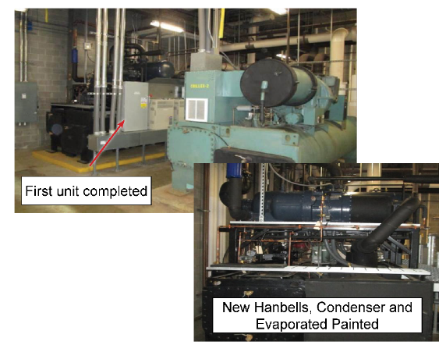
Upgrades
For Contractors on older chillers
Carrier Chiller Richmond, Virginia
Concerns:
Use of the building changed from a Data Center to a mixed office space, Carrier units oversized for building which caused short cycling in the Spring and Fall seasons.
Steps Taken:
Decision made to replace single compressor with two Hanbell screw compressors with VFDs and adding MCS Controls.
Notes:
Talk about older chillers in need of control upgrades, and adding a more reliable compressor with VDF control.

Slide 16
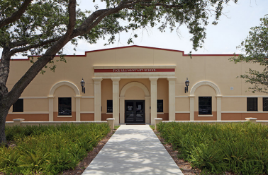
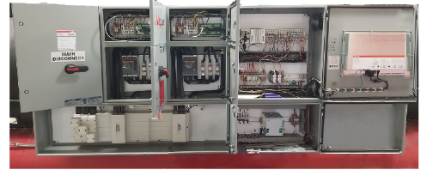

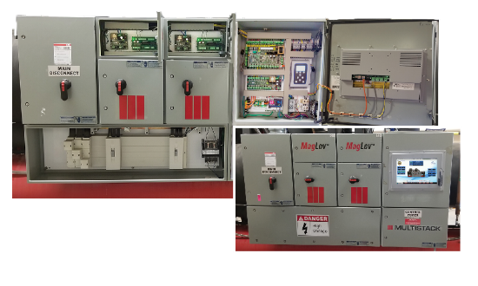
Upgrades
for more user-friendly performance
Concerns:
MCS controls have been installed in many of the Lee County Schools in Fort Myers.
The older Controls were updated for smoother operation and user-friendly performance.
BEFORE
Steps Taken:
Remove manufacturer’s controls and replaced with MCS controls,
MCS Sensors, MCS-MODBUS,
MCS-EXV Driver, etc
AFTER
Notes:
This slide shows where we were asked to change out controls used on this installation. Controls on this chiller were not ‘user friendly’.
The Lee County school district uses MCS Controls on most of their chillers and have been happy with their reliability and performance.

Slide 17
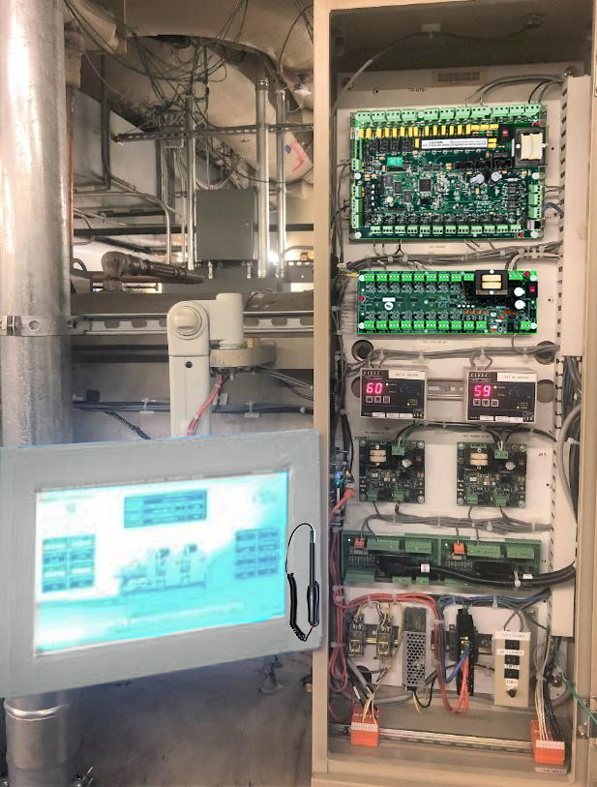
MCS Magnum Controller
MCS-EXV Drivers, etc.
MCS-Magnum
&
MCS-SI16-A04
MCS-EXV Driver
&
MCS-Modbus
Notes:
Emphasize how MCS products and other products work on controlling chillers.

Slide 18
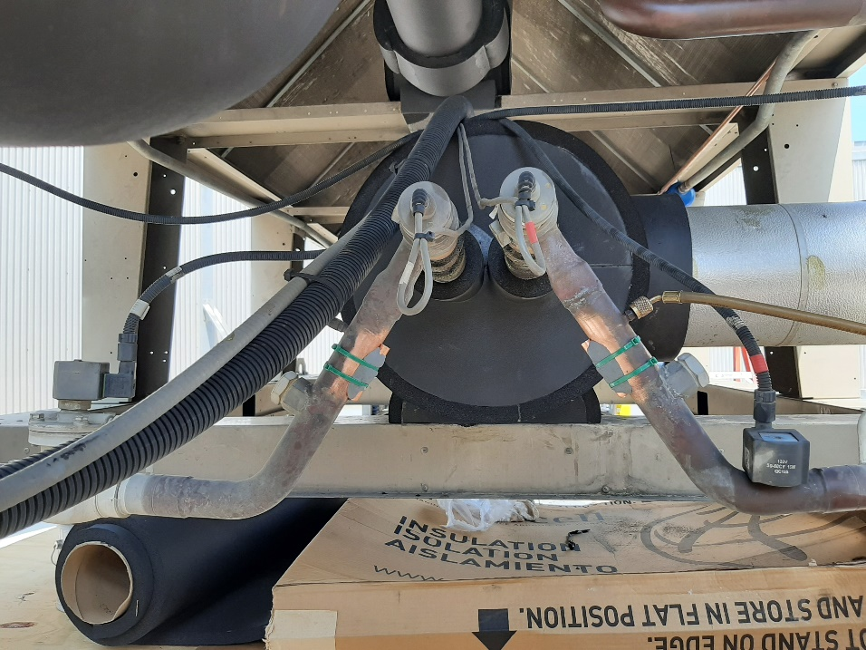
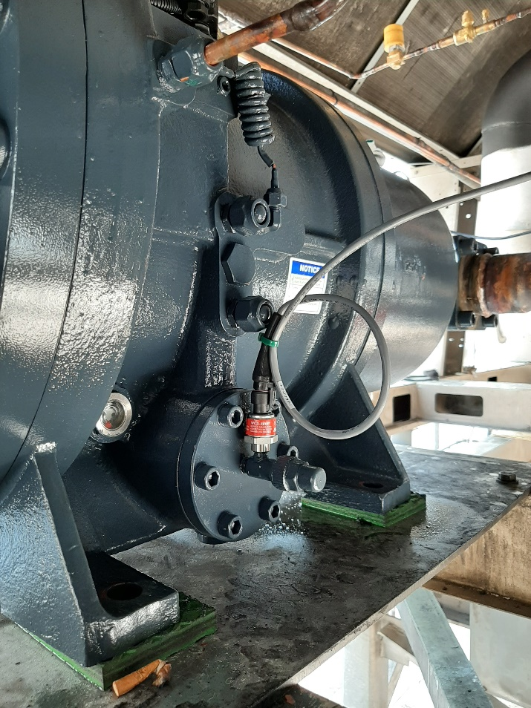
Pressure Transducer and
Temperature Sensors monitoring Compressor
MCS Pressure Transducers
MCS Pressure Transducers, MCS Temperature Sensors
MCS Pressure Transducers
Notes:
Temperature sensors, pressure transducers are an important part of controlling the units they are monitoring.

Slide 19
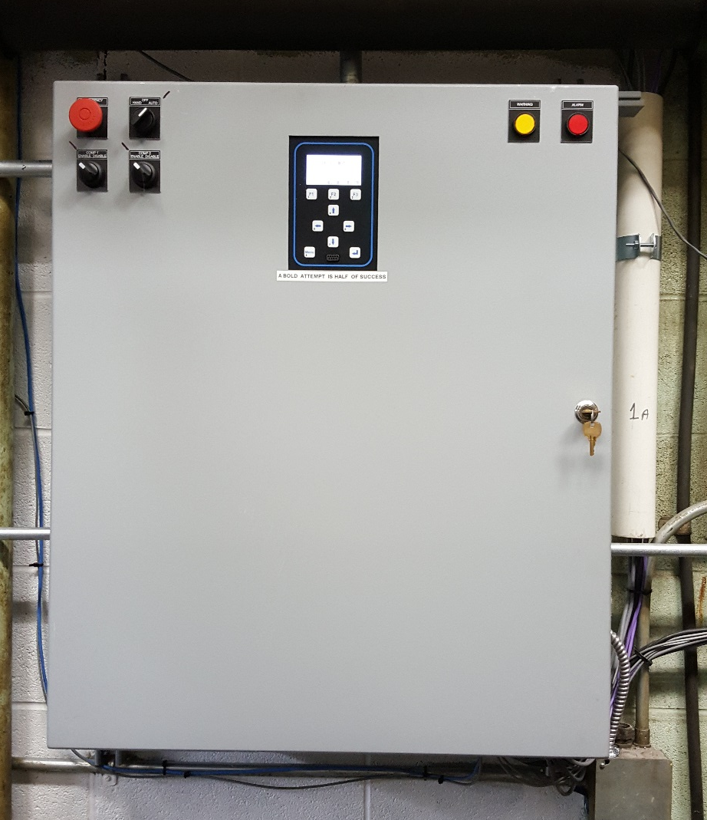
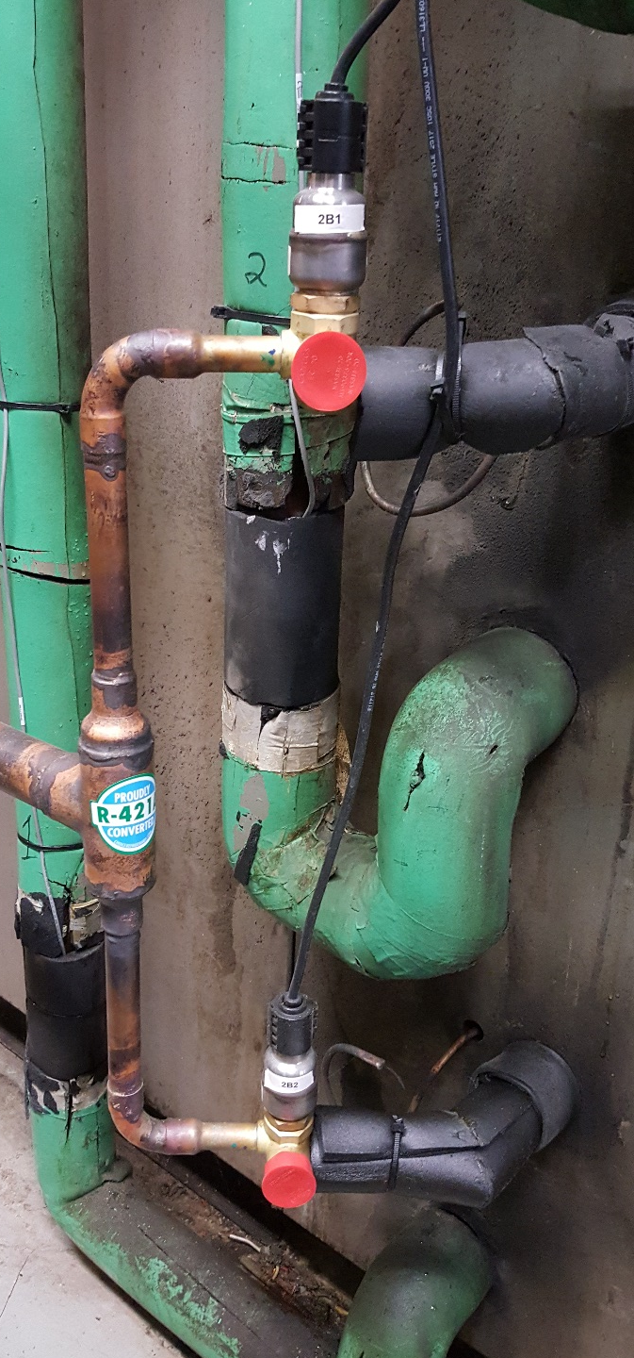
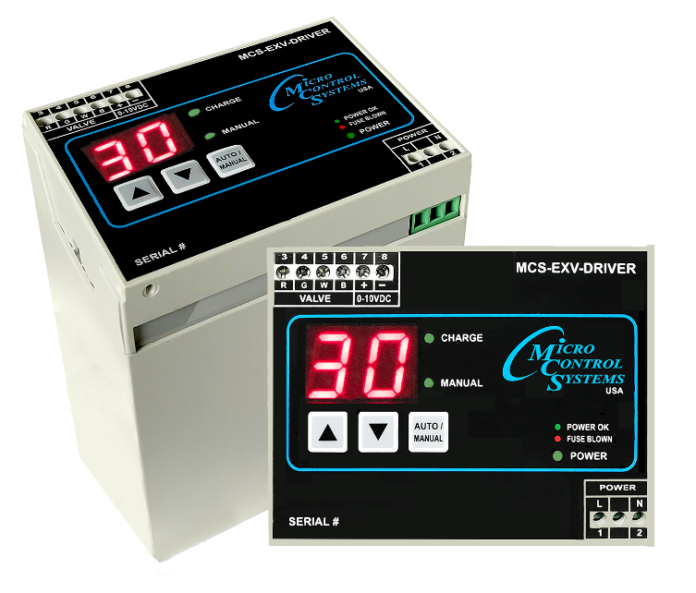
MCS-EXV-DRIVER
& Sporlan EXV’s Installed
MCS-EXV DRIVER mounted in MCS Control Panel
Notes:
Talk about the important part of the EXV Driver and Sporlan EXV’s controlling superheat.

Slide 20
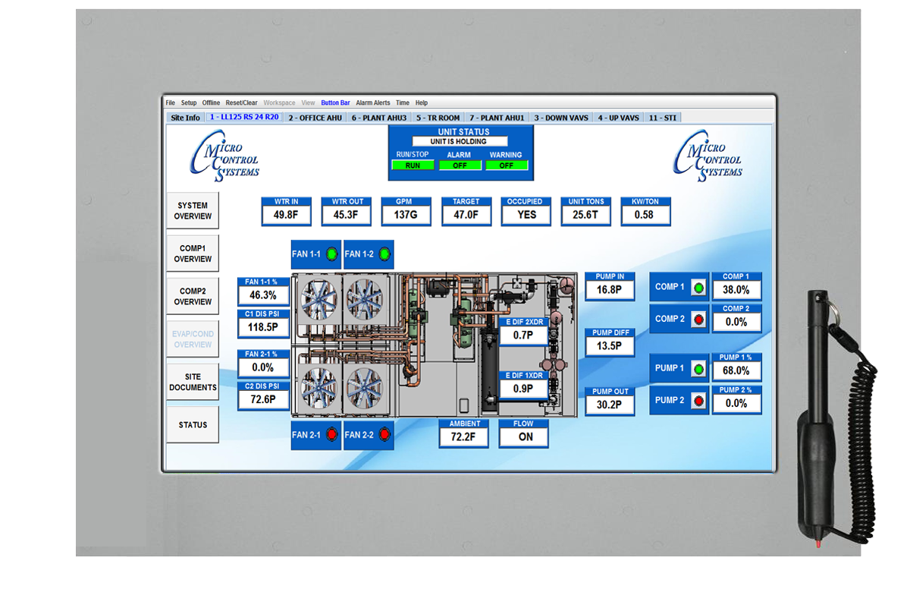
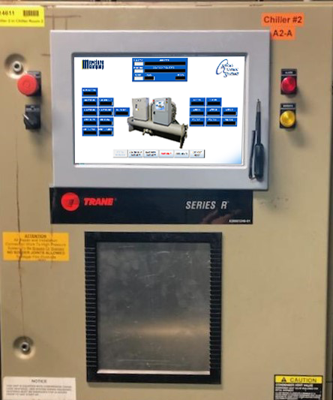
MCS Touchscreen with Graphics
upgraded in Chiller
MCS-15.4 Touchscreen
mounted to Enclosure
Following control switches added:
Emergency Stop push knob
Hand off / on switch
Alarm light
Warning light
Notes:
Talk about the MCS-TOUCHSCREEN and how this makes using MCS controls easier for technicians to see critical temperatures, etc.
Moving animated graphics are used on the touchscreens

Slide 21
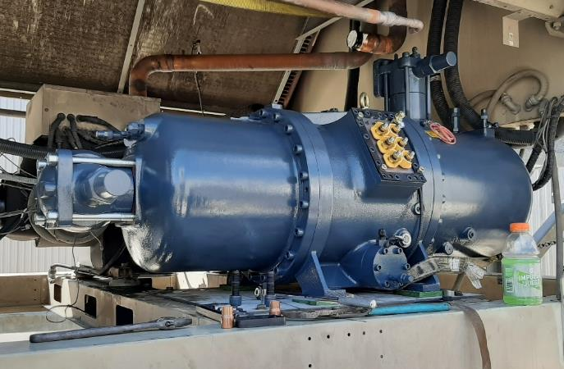
Hanbell Compressor Upgrade
Power Drink for technician, not for adding to Hanbell compressor!! Ha! Ha!
Notes:
Hanbell a reliable partner for upgrading chillers in the field. Stocked in two locations in the US.

Slide 22
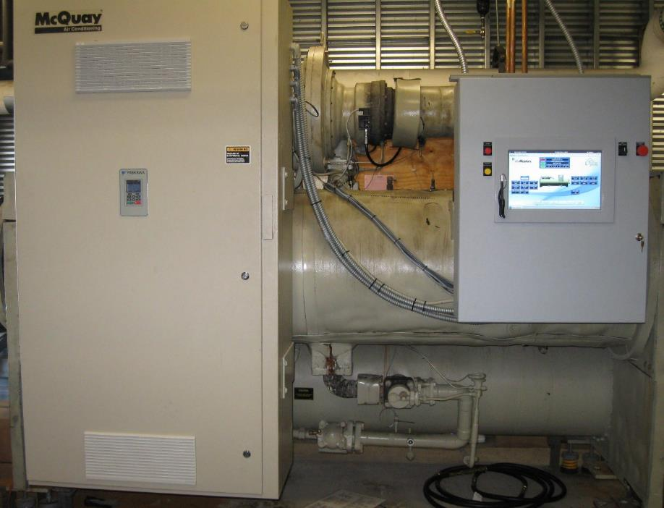
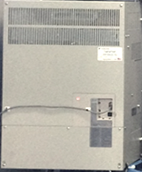
Upgrade Centrifugal Chillers
to MCS & VFD’s
New
MCS-Centrifugal Panel
w/ 15.4 Touch Screen
New
Yaskawa A1000 VFD using existing cabinet
Notes:
Vdf’s are important in proving longer life for compressors, fans etc.

Slide 23
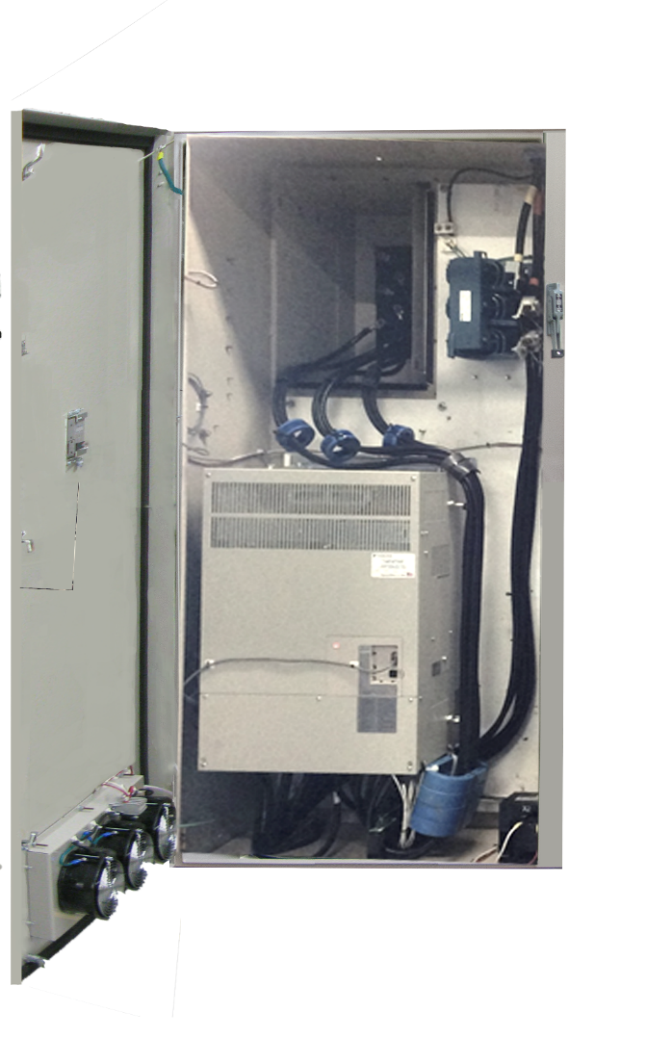
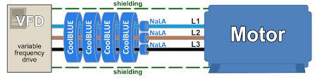
Yaskawa AS1000 VFD
with CoolBlue Absorbers from MCS
MTE Line Reactor
Yaskawa A1000 VFD
31.5 H x 19.84 W x 13.78 D
CoolBLUE Inductive Absorbers
Notes:
Another new product for MCS is the installation of ‘CoolBlue Absorbers on VFD’s to monitor the current used.

Slide 24

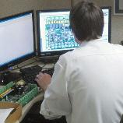
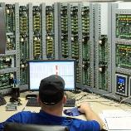
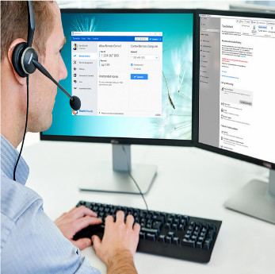
Phone
Tech Support
Software
Remote Connection
Team
Viewer
Notes:
Support is a key part of the service we offer to our OEMs and Contractors anywhere in the world.
We can be reached by phone and remote log into the controller.

Slide 25

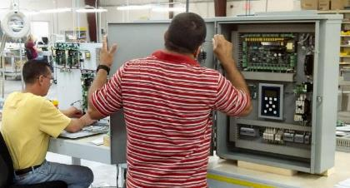
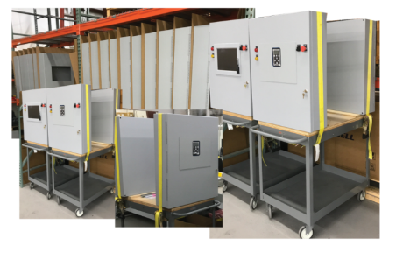

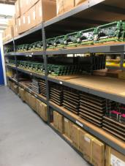
Enclosures in stock with Touchscreens, Keypads, etc.
MCS Technician adds finishing touch
to in stock Enclosure from inventory.
Standard shipping
5-7 days
Expedited 2-4 days $$
Notes:
Emphasize we build control enclosures for inventory and can ship, If necessary in 2 to 4 days. Normal turnaround is 5-7 days
Go over how we build 3 basic enclosure sizes and most boards used are the same.
With the new 12volt systems, expansion is easy, adding an extension board to the base expansion board.

Slide 26
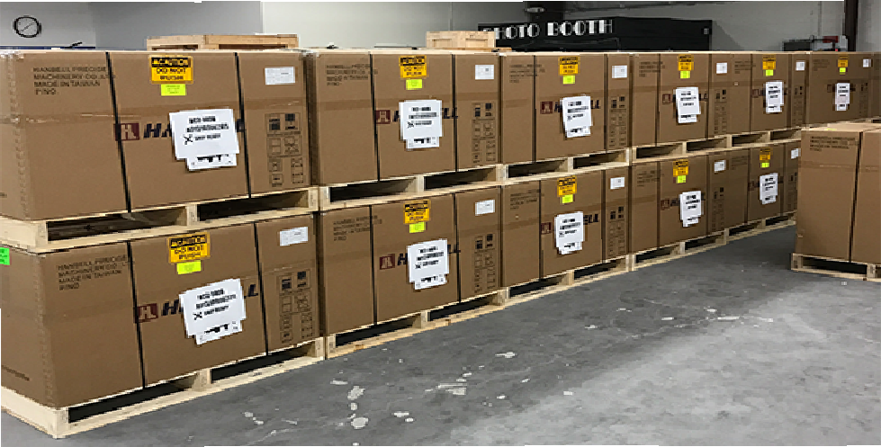


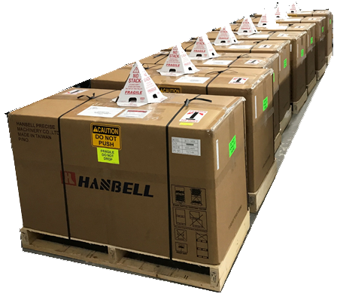
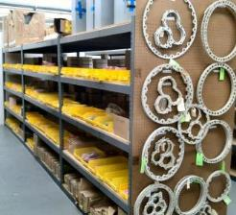
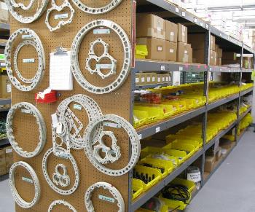
Our Screw Compressor Stock
Two stocking locations – Florida and the West Coast
Over 125 compressors in stock
Over 75 compressor stators in stock
Spare parts stocked at both locations
Notes:
Emphasize that compressors are stored in two locations in US and that we can change compressors motors, to flooded, etc right here in our plant.

Slide 27
Getting in Touch with MCS
Support for all Products: support@mcscontrols.com
Ian Mitchell John Boutwell Michael Frazier Clayon Dahi John Sims
Application Specialist - Firmware, Software, Support, Sales: applications@mcscontrols.com
Daniel Chapman
Pricing / Sales on product line: sales@mcscontrols.com Telephone 239-694-0089
James Mitchell Victor Gray Carlos Giraldo Kelly Mitchell
Placing an order: orders@mcscontrols.com Telephone 239-694-0089
John Toney Kelly Mitchell
Status of an order, shipping: orders@mcscontrols.com Telephone 239-694-0089
Kelly Mitchell John Toney
RMA (Return Merchandise Authorization): orders@mcscontrols.com Telephone 239-694-0089
Kelly Mitchell John Toney
Notes:
Make sure everyone understands how to get in touch with MCS and who are some of the key people in departments.

